Slide 1
IN OR OUT? The voters who will decide
Matthew Goodwin
David Cutts

Slide 2
What data are we using?
YouGov cross-sectional online sample, 4317 British adults
Fieldwork dates Nov 20-24 2015
Exclude ‘won’t vote’ = 4166 sample
Respondents subdivided into four groups based on view:
Hard Remain: will definitely vote to Remain in EU
Hard Leave: will definitely vote to Leave
Soft Remain: will probably vote remain/could be persuaded to Leave
Soft Leave: will probably vote to leave/could be persuaded to Remain
Unsure: no idea whether I would vote for Britain to Remain or Leave

Slide 3
Hard Remain 29%
Deciders and Drifters: The groups who will decide if we stay or go…..
Hard
Leave
27%
V
Soft
Remain
19%
Soft
Leave
17%
+
UNSURE
8%

Slide 4
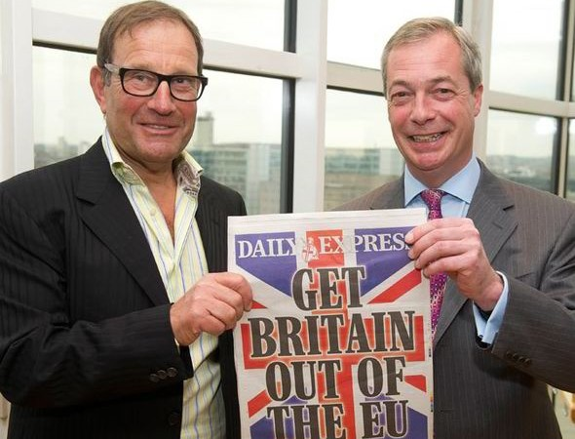
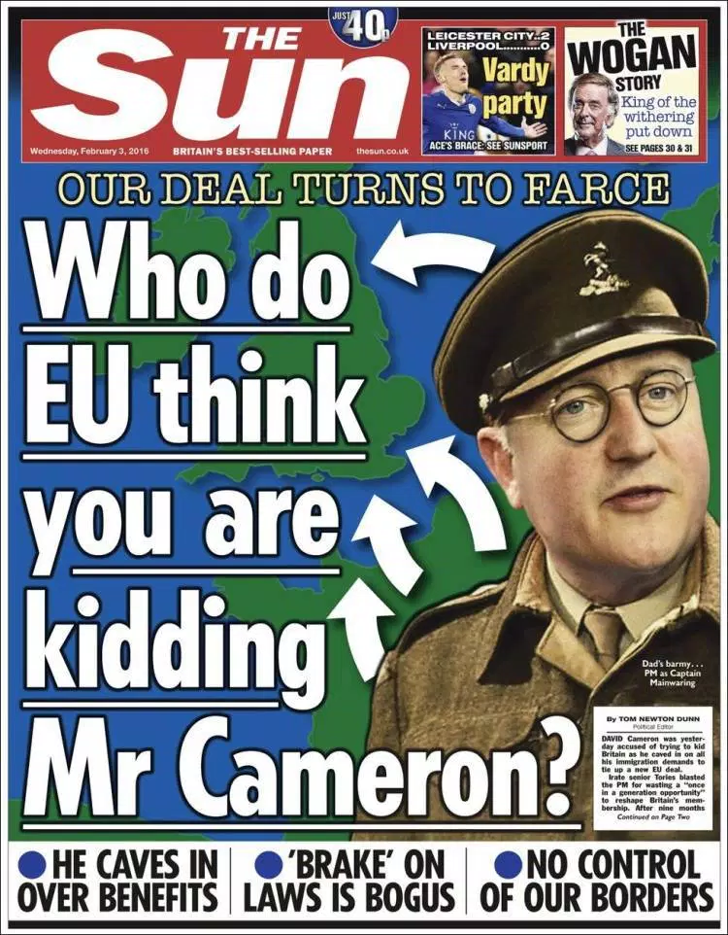
Hard Leave (vs. overall sample)
73% aged 45+ (vs. 57%)
Drawn from lower middle/w.class
Read tabloid papers
Stronger in Midlands & South
English: 43% English not British (28%)
Brexit good for jobs/Global influence
87% see Brexit as safe option (40%)
61% Brexit good for NHS (32%)

Slide 5
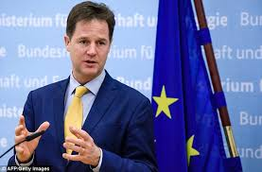
Hard Remain (vs. overall sample)
52% aged 18-44 years old (43%)
Drawn from higher middle/m.class
More likely to read broadsheets
North, South & slight London effect –no big diff
More British than English
Clear about perceived risks of Brexit
91% see Brexit as risk (46%)
82% think if leave worse off (33%)
77% UK will have less influence (35%)
77% bad for jobs (32%)

Slide 6
Englishness – it’s v important!

Slide 7
An opening for the Remain camp? Hard leave voters less convinced that things will be better post-Brexit, compared to Hard Remain belief in negative consequences

Slide 8
An opportunity for the Leave camp? Voters, including soft remain, appear open to idea Brexit would be good for the NHS (net good effect, excluding make no difference)

Slide 9
Soft Leave & Soft Remain – the key battle
Soft Leave
Soft Remain
Slightly more likely to be female
More likely to be 30-60+ years old
From lower social classes
Read tabloid newspapers
Based in Midlands & East England
Less likely to be found in London
More likely than any other to id as Con
Leaned heavily to Cons at 2015 GE
Less likely to have voted Ukip
Identify as English
Less interested in politics/to talk EU Ref
More likely to trust Farage, Cameron
Less likely to trust Corbyn
Slightly more likely to be female
Younger, 18-44 years olds
Drawn from econ secure AB/C1 grades
More likely to read broadsheets
More northern & London, less eastern
Less likely to ID as English
Lean to Cons like overall sample
Slightly more likely to voted Con 2015
Less interested in politics/to talk EU Ref
More likely to trust Cameron
Notably less likely to trust Farage

Slide 10
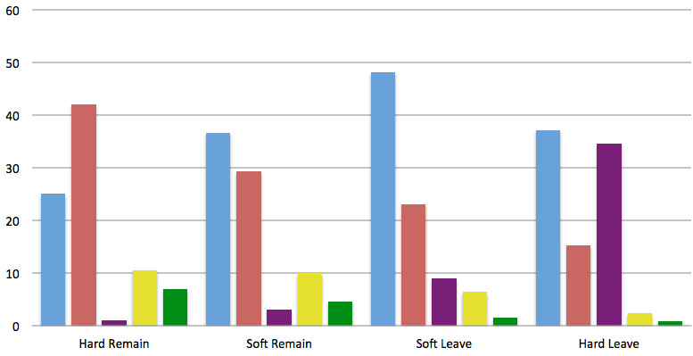
Views by 2015 GE vote

Slide 11
Trust in leaders

Slide 12
What soft leave, soft remain & unsure think

Slide 13
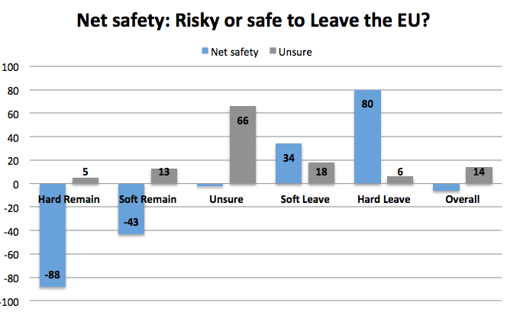
Risk versus Safety

Slide 14
Thanks! @GoodwinMJ

Slide 15
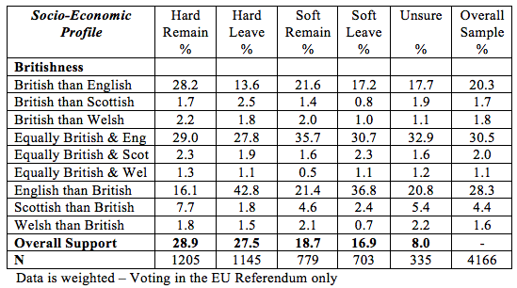
National ID and the EU Ref

